Slide 1

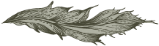
Project Title: CI/CD - DevOps Duration: 01/09/2025 – 30/09/2025 Organization: Sunbeam Institute Of Information Technology
Submitted by: Neha Sanjay Kumbharde

Slide 2

Agenda / Roadmap
Day 1 (01/09/2025): Docker install, build Docker image, launch two containers (app + DB)
Day 2 (09/09/2025): Create two VMs, set up Kubernetes cluster
Day 3 (12/09/2025): Deploy application in Kubernetes (Deployment + Service)
Day 4 (15/09/2025): Add persistence (PV/PVC), set up CI/CD (GitHub Actions + ArgoCD + Helm)
Day 5 (22/09/2025): Monitoring with Prometheus + Grafana + Alerts, integrate with pipeline

Slide 3
Day 01: Docker Setup and App Containerization
Operating System: Ubuntu/Debian (Linux base environment)
Containerization: Docker (installing Docker Engine, Docker CLI, Docker Compose optional)
Dockerfile: Used to create a custom Docker image for the Todo app
Containers:
a) One container for database (likely MySQL/Postgres/MongoDB)
b) One container for the Todo app (Flask/Django/Node.js app)
Technologies used: 🔹 Linux (Ubuntu/Debian), Docker, Dockerfile, Containerization

Slide 4
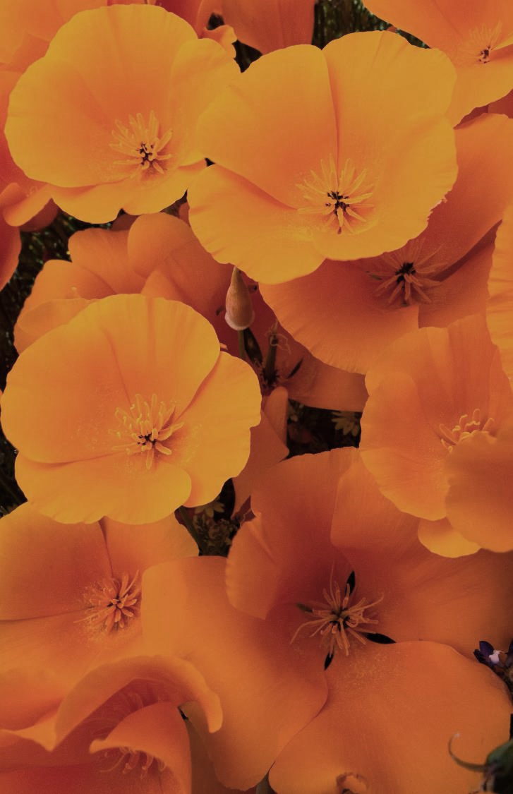
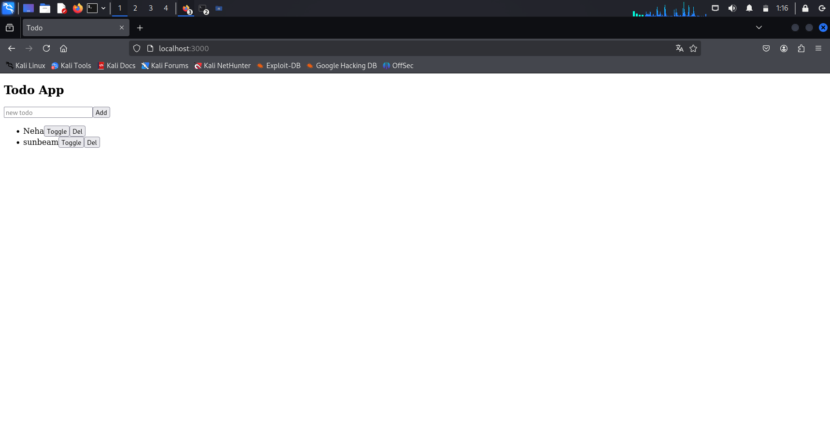

Slide 5
Day 2 — Kubernetes Cluster Setup
Virtual Machines (VMs): Created 2 VM instances (on local VirtualBox, VMware, or cloud like AWS/GCP/Azure)
Kubernetes (k8s): Installed and configured a Kubernetes cluster (using kubeadm, minikube, or kind)
Networking & Cluster Management: kubeadm, kubectl CLI
Steps:
Provision two VMs (could be on local VM hypervisor or cloud)
Install kubeadm, kubelet, kubectl on both
Initialize control-plane on VM1: kubeadm init ...
Join VM2 as worker: kubeadm join ...
Install a CNI (e.g. Calico, Flannel) for pod networking
Confirm nodes are Ready: kubectl get nodes
Technologies used: 🔹 Virtualization (VMware/VirtualBox/Cloud VMs), Kubernetes, kubeadm/kubectl

Slide 6

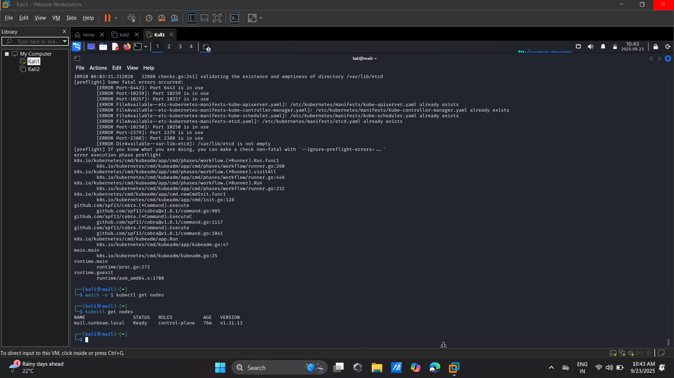
Selecting visual aids
Enhancing your presentation

Slide 7
Day 3 — Kubernetes Deployment & Service
Ojectives:
Deploy the Todo App and Database to Kubernetes.
Create Deployment and Service YAML files.
Kubernetes Deployment: Defined workloads for app + database using YAML Deployment files
Technologies used: 🔹 Kubernetes, YAML (K8s Manifests), Deployments, Services

Slide 8
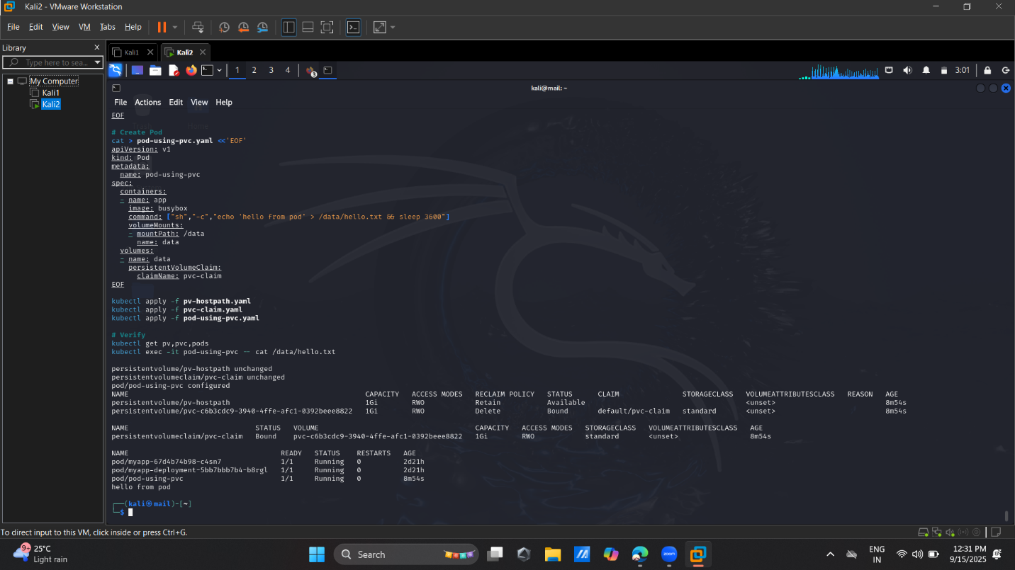

Slide 9
Day 4 : Add persistence (PV/PVC), set up CI/CD (GitHub Actions + ArgoCD + Helm)
Objectives:
Understand and implement Persistent Volume (PV) and Persistent Volume Claim (PVC)
Set up CI with GitHub Actions and CD with ArgoCD
Use Helm to template deployments
Persistent Volumes (PV) & Persistent Volume Claims (PVC): Kubernetes storage for database/app data
CI/CD:
a)GitHub Actions → Continuous Integration (build, test, push Docker images, deploy to cluster)
b) ArgoCD → Continuous Deployment (GitOps for Kubernetes)
Helm: Used Helm charts to manage Kubernetes manifests (packaging, templating, versioning)
Technologies used: 🔹 Kubernetes Storage (PV, PVC), GitHub Actions (CI), ArgoCD (CD), Helm

Slide 10
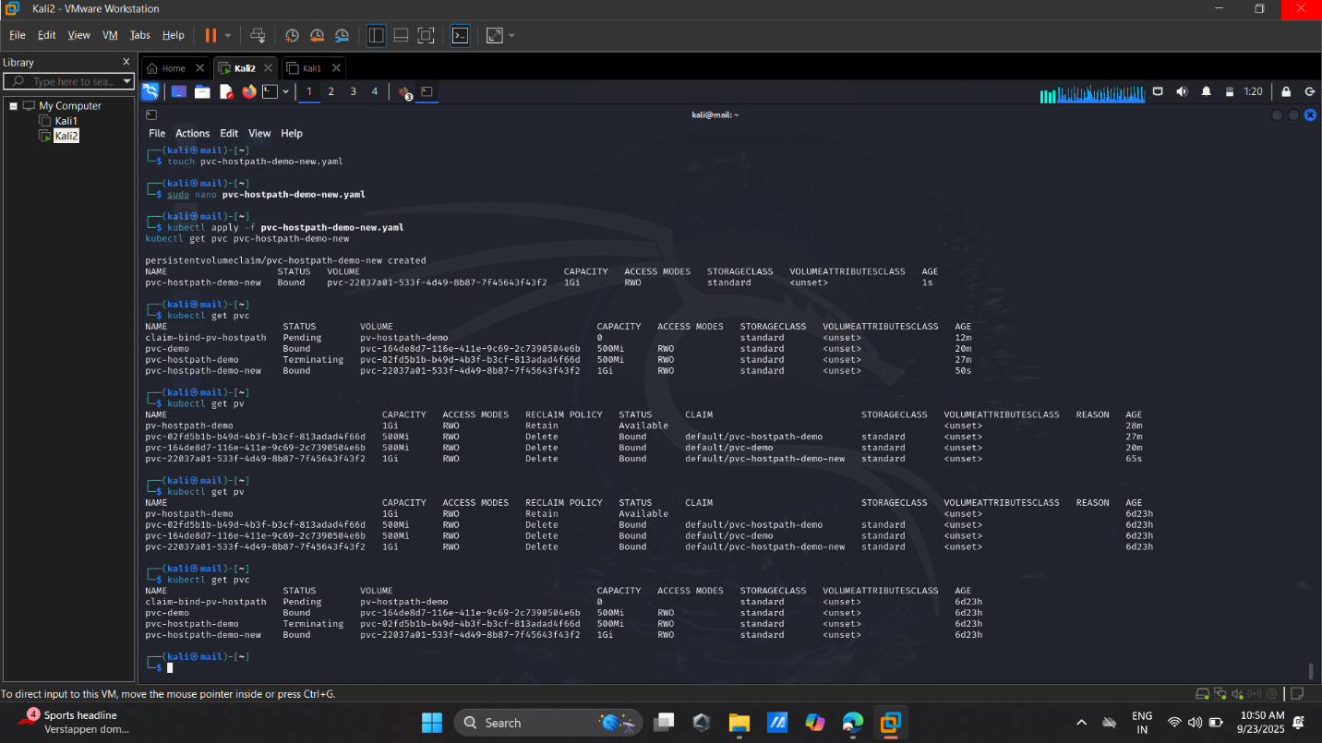

Slide 11
Day 5 — Monitoring with Prometheus
Objectives:
Set up Prometheus and Grafana for monitoring
Create Dashboards and Alerts
Technologies used: 🔹 Prometheus, Grafana, Alertmanager, Monitoring & Alerting Stack
Prometheus: Metrics collection (application
+ Kubernetes cluster monitoring)
Grafana: Dashboard visualization of metrics
Alerting: Prometheus Alertmanager + Grafana Alerts (Slack, Email, PagerDuty, etc.)
Integration with CI/CD: Monitoring hooks with ArgoCD/GitHub Actions

Slide 12
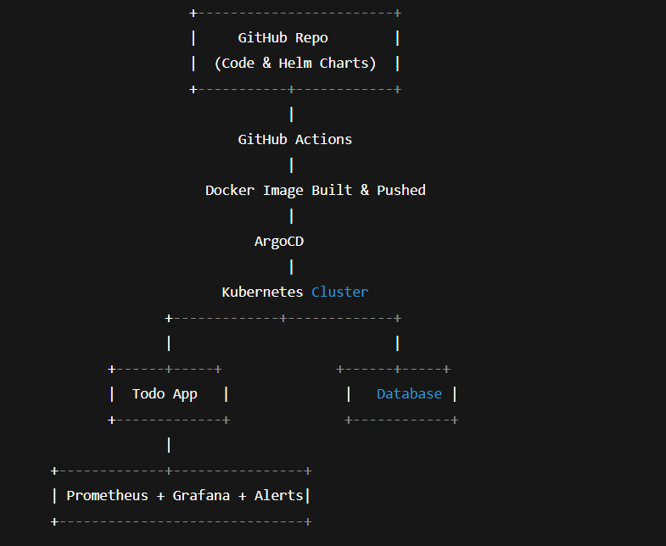
Final Architecture Overview:

Slide 13
Thank you
Neha Sanjay Kumbharde
nehakumbharde1999@gmail.com

